Slide 1
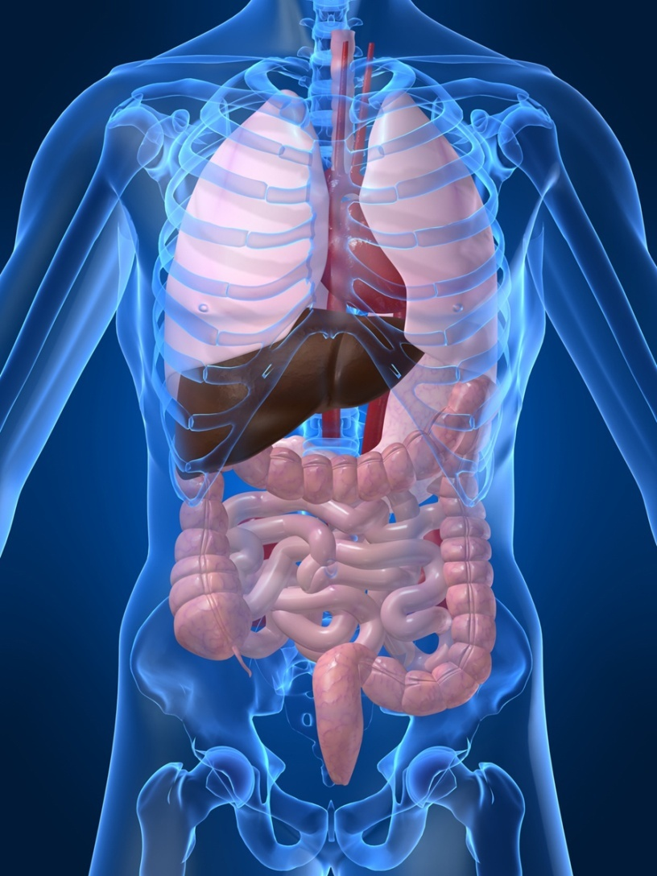
PTA/OTA 106 Unit 2 Lecture 5

Slide 2
Processes of the Respiratory System
Pulmonary ventilation
mechanical flow of air into and out of the lungs
External Respiration
exchange of gases between the pulmonary air spaces and the blood
Internal Respiration
exchange of gases between blood and tissues

Slide 3
Structural Portions of the Respiratory System
Lower Respiratory System:
Contains a set off conducting ducts that carry air to the exchange surfaces.
Know order from largest to smallest.

Slide 4
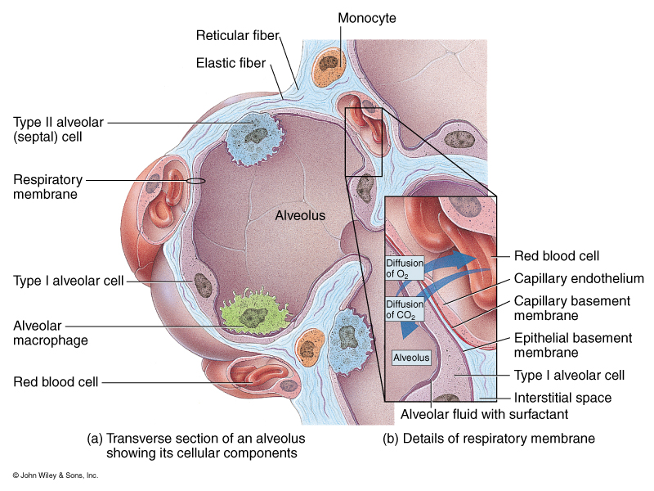
Structural Portions of the Respiratory System
Lower Respiratory System
Respiratory Portion

Slide 5
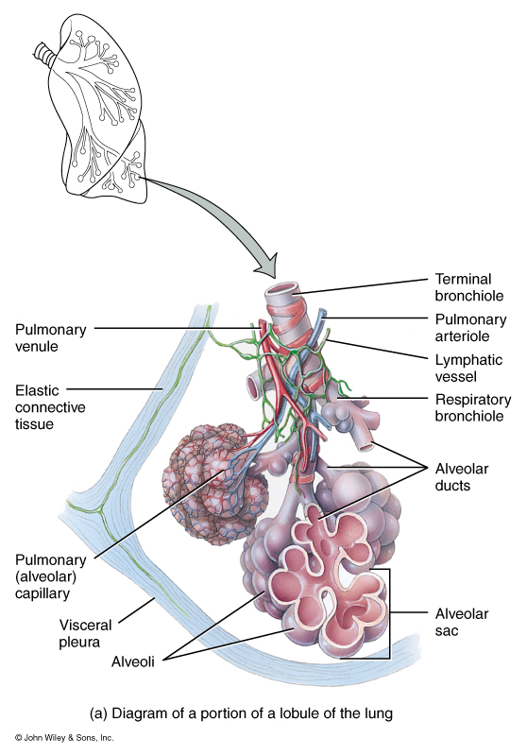
Microscopic Anatomy of a Lobule

Slide 6
Pulmonary Ventilation Inspiration
Muscles of Inspiration
Primary Muscle
Diaphragm – only muscle active during normal breathing or eupnea
Secondary Muscles
Active during deep breathing
Sternocleidomastoid
Scalenes
External Intercostals

Slide 7
Pulmonary Ventilation Expiration
Muscles of Expiration
Primary Muscle
Diaphragm is inactive
Secondary Muscles Active during deep breathing
Internal intercostals
External Oblique
Internal Oblique
Transversus Abdominis
Rectus Abdominis

Slide 8
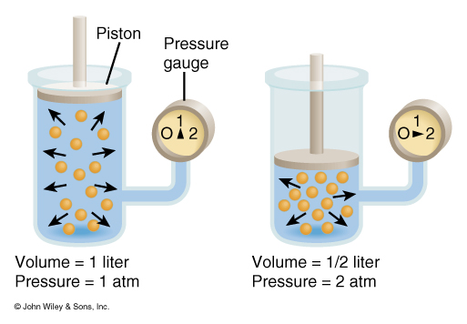
Pressure Changes in Pulmonary Ventilation and Boyle’s Law
Pressure is inversely related to Volume

Slide 9
Summary of Inspiratory and Expiratory Events

Slide 10
Factors Affecting Pulmonary Ventilation
Surface Tension
Surfactant decreases surface tension thus preventing alveolar collapse
Compliance
High compliance means the lungs and thoracic wall expand easily
Low compliance means that they resist expansion

Slide 11
Factors Affecting Pulmonary Ventilation
Decreased Compliance
Tuberculosis: scarring of the lungs
Pulmonary edema: Retention of fluid in lung tissue
Respiratory distress Syndrome: Lack of surfactant in premature infants
Paralysis of respiratory muscles
Increased Compliance
Emphysema: destruction of elastic fibers in alveolar walls

Slide 12
Factors Affecting Pulmonary Ventilation
Airway Resistance
Any condition or obstruction of airways that increases resistance.
Chronic Obstructive Pulmonary Disease (COPD) asthma
Chronic Bronchitis

Slide 13
Lung Volumes and Capacities

Slide 14
Factors affecting External Respiration
Partial Pressure of gases
Alveolar surface area
Diffusion rate and distance
Solubility of each gas and molecular weight of the gas
Hemoglobin affinity

Slide 15
Factors affecting External Respiration
Dalton’s Law – Atmospheric pressure is the sum total of all partial pressures of all gases in the atmosphere
N2 78% 597.4mmHg
02 21% 158.8mmHg
CO2 >1% .3mmHg

Slide 16
Factors affecting External Respiration
Dalton’s Law and High Altitude sickness
Sea Level: pO2 160mmHg
10,000ft.: pO2 110mmHg
20,000ft.: pO2 73mmHg
50,000ft.: pO2 18mmHg

Slide 17
Factors affecting External Respiration
Henry’s Law
Quantity of a gas that will dissolve in solution is proportional to the partial pressure and the solubility coefficient (SC) of the gas.
SC CO2 = .57
SC O2 = .024
SC N2 = .012

Slide 18
Factors that effect Oxygen Transportation by Hemoglobin
pH (blood acidity)
Partial pressure of CO2
Blood Temperature
2,3-bisphosphoglycerate
(BPG)

Slide 19
The Effect of Blood pH on the Affinity of Hemoglobin for O2
Increased pH of blood (more basic) the greater the affinity
Decreased pH of blood (more acidic) the lower the affinity

Slide 20
The Effect of pCO2 on the Affinity of Hemoglobin for O2
Low pCO2 the higher the affinity
High pCO2 the lower the affinity
H2O + CO2
Bohr Effect
H20 + CO2 Carbonic Acid (H2CO3) H+ + HCO3

Slide 21
The Effect of Blood Temperature on the Affinity of Hemoglobin for O2
Lower the temperature the greater the affinity
Higher the temperature the lower the affinity

Slide 22
The Difference between Fetal and Maternal Hemoglobin for O2 Affinity
For efficient gas exchange between a fetus and it’s mother,
Fetal hemoglobin has a higher affinity for O2 then maternal hemoglobin.

Slide 23
Summary of gas Exchange during both external and Internal Respiration
O2 is carried on hemoglobin forming Oxyhemoglobin.
7% of CO2 is carried as dissolved CO2
25% of CO2 is carried as carbaminohemoglobin
70% of CO2 is carried as bicarbonate ions

Slide 24
Summary of gas Exchange during both external and Internal Respiration
Haldane effect: The lower the oxyhemoglobin, the higher the CO2-carrying capacity of the blood.
Deoxyhemoglobin binds more readily with CO2
Deoxyhemoglobin also acts as a better buffer absorbing more H+, causing more bicarbonate to form.

Slide 25
Nervous Control of Pulmonary Ventilation and the of respiratory centers
MRA: Controls the basic rhythm of ventilation
PA: transmits inhibitory impulses to the inspiratory area
AA: Transmits stimulatory impulses to the inspiratory area

Slide 26
Proposed mechanism of ventilation control

Slide 27
Chemical Regulation of Respiration
Aortic Body: Cluster of chemoreceptors located in the wall of the aortic arch that respond to H+
Carotid Bodies: Cluster of chemoreceptors located in the walls of the L & R Carotid arteries that respond to H+
Central Chemoreceptors: located in the Medulla Oblongata also respond to H+

Slide 28
Clinical Terms
Hypercapnia: Arterial Blood PCO2 above 40mmHg
Hypocapnia: Arterial Blood PCO2 below 40mmHg
Hyperventilation: Rapid/deep breathing
Hypoventilation: Slow/shallow breathing
Hypoxia: O2 deficiency at the tissues
Hypoxic hypoxia: due to high altitude, airway obstruction, or fluid
Anemic hypoxia: deficiency fo hemoglobin
Ischemic hypoxia: decreased blood flow
Histotoxic hypoxia: Caused by toxic agent such as cyanide which prevents tissues from using O2

